Slide 1
K-NEAREST NEIGHBORS (KNN)
BY GROUP 21
NAMES | REG. NO | STUDENT. NO
NIYONSABA ALEX | 16/U/10344/EVE | 216004565
CHEPKURUI JACOB ISAAC | 16/U/4608/EVE | 216016754
SAMIR HABIB | 16/U/11334/EVE | 216016914
OKOTH BRAIN | 16/U/10926/EVE | 216002929

Slide 2
WHAT IS K-NN?
KNN is a non-parametric supervised learning technique in which we try to classify the data point to a given category with the help of training dataset.
The algorithm is a lazy learner because it does not learn much from the training data.

Slide 3
HOW DOES KNN WORK?
There are two approaches in which K-NN works.
K-NN CLASSIFICATION
In classification new data points get classified to a particular class .Classifiers try to predict a category.
K-NN REGRESSION
In case of regression new data gets labeled based on the average value of k nearest neighbors.
Tries to predict the real number

Slide 4
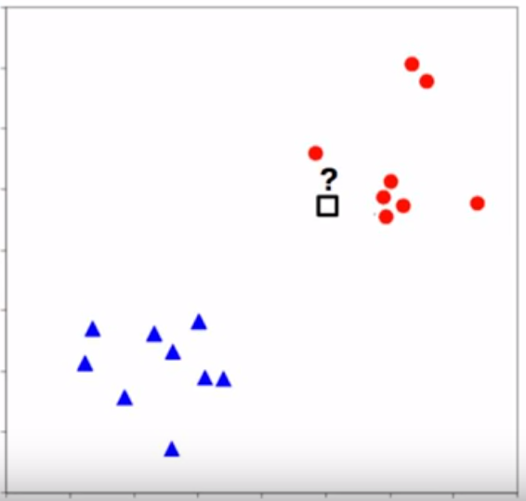
K-NN CLASSIFICATION
Which color is it?

Slide 5
K-NN CLASSIFICATION
HEIGHT (IN CMS) | WEIGHT (IN KGS) | T SHIRT SIZE
158 | 58 | M
158 | 59 | M
158 | 63 | M
160 | 59 | M
160 | 60 | M
163 | 60 | M
163 | 61 | M
160 | 64 | L
163 | 64 | L
165 | 61 | L
165 | 62 | L
165 | 65 | L
168 | 62 | L
168 | 63 | L
168 | 66 | L
170 | 63 | L
170 | 64 | L
170 | 68 | L
Illustrate Scatter
Voronoi Tessellation
Partitioned into regions for their classes
Decision Boundary
Boundary That separates one classification from another
Isolated
One Variable among different ones
Solution(increase k)
.

Slide 6
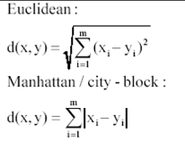
K-NN CLASSIFICATION
Step1:Calculate Similarity based on distance function
There are many distance functions but Euclidean is the most commonly used. Another example is Manhattan distance function.

Slide 7
K-NN CLASSIFICATION
New customer named ‘Karius’ has height 161cm and weight 61kg.
=SQRT((161-158)^2+(61-58)^2)
=4.2
Step 2 : Find K-Nearest Neighbors

Slide 8
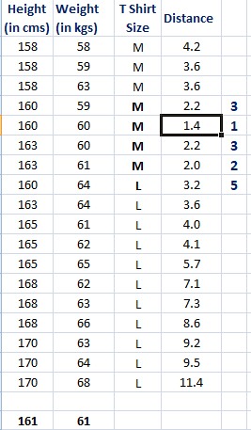
K-NN CLASSIFICATION

Slide 9
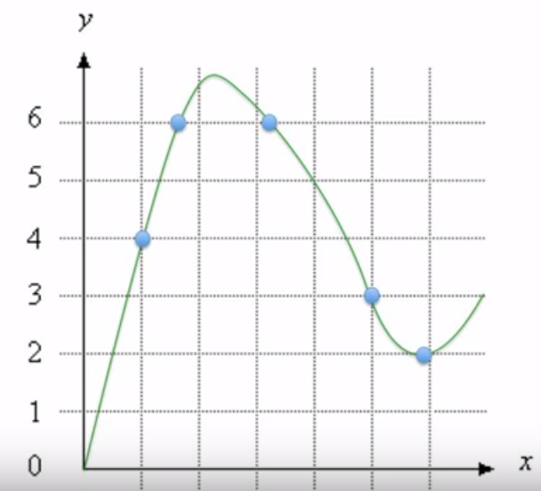
K-NN REGRESSION
Get the mean
For X=4;
k=1
k=2
k=3
What about for X =0

Slide 10
REQUIREMENT FOR THE K-NN ALGORITHM
Generally K gets decided based on the square root of the training data.
Data normalization.
Installation of the “class” library to implement in R.
Now lets go a head to implement our K-NN algorithm in R.

Slide 11
Applications of k-nn
In political science , classing a potential voter to a “will vote” or “will not vote”, or to “vote FDC” or “vote NRM”. For example Facebook was used in USA.
In credit rating, assuming we have two or more people with similar financial features, these would be given the same credit ratings. Here we are also able to predict the credit rating of the new customer.
In image recognition for example in x-ray analysis of organs.
When the bank is to give a loan to an individual. Would an individual default on his or her loan? Is that person closer in characteristics of people who defaulted or did not default on their loans?

Slide 12
Advantages of k-nn
No assumption about the data.
Has got a relatively high accuracy.
Versatile, it can be used in classification and regression.

Slide 13
Disadvantages
Computationally expensive because the algorithm stores all of the training data. High memory requirement.
Prediction stage might be slow when it comes to huge amounts of data.

